Slide 1

Liquibase
Notes:
Hello my name is Donatas I’m a software engineer at EPAM Lithuania..
ill be talking with you about Liquibase as requested by one of you, and explain the basics of this technology and how it works..

Slide 2

Light talk authors
Donatas Barkauskas,
Software Engineer

Slide 3
What is database schema migration?
Schema migration – process of changing database schema. For example, adding or removing a column in an existing table.
It can be done with SQL command:
ALTER TABLE Customers ADD Email varchar(255);

Slide 4
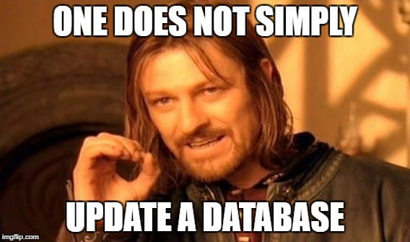
Why is database schema migration difficult?
How to be sure you don’t make mistakes when applying changes to production database by hand?
How to check which changes were already applied?
How to reliably check that migration is safe?
What to do if a part of the changes fail?
How to sync schema changes with application changes?

Slide 5

Solution to database migration
Liquibase is an open-source database schema change management solution which enables you to manage revisions of your database changes easily

Slide 6
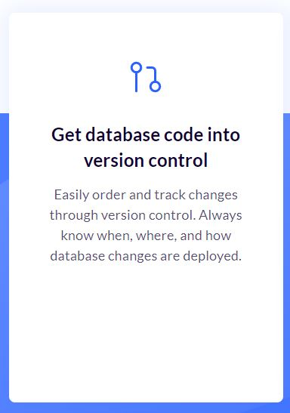
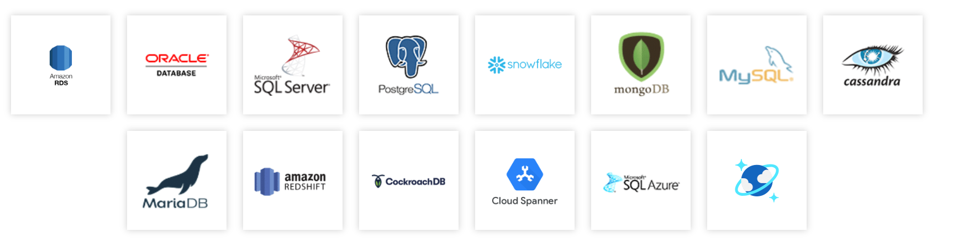
Liquibase advantages
Liquibase allows you to have a log of changes made by developers.
It provides automatic rollback operations on failed executions.
It supports more than 50 databases
Notes:
Well the first question should be what is Liquibase ?
In short it’s a powerful open-source migration tool for databases.
But the short version doesn’t tell us a lot, so ill give you a bit longer version.
(forward)
Liquibase is powerful because it allows you to have a paper trail so to speak of the database changes.
(forward)
This is what Liquibase says in their website about this feature.
Another big feature is automatic rollback operations.
(forward)
Which means that if an update fails it rollback to the previous update.
Removing the changes made in the failed update

Slide 7
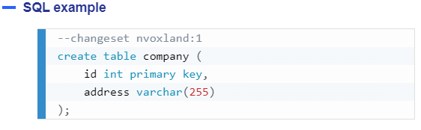
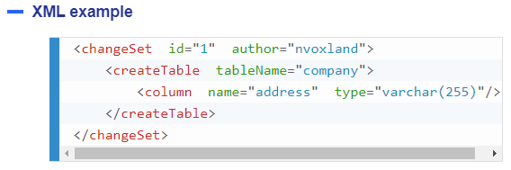
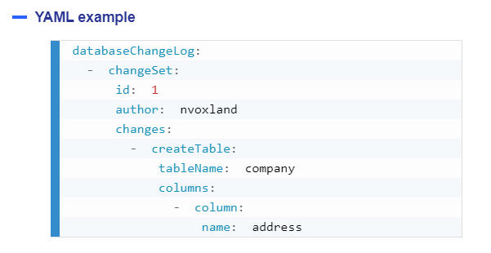
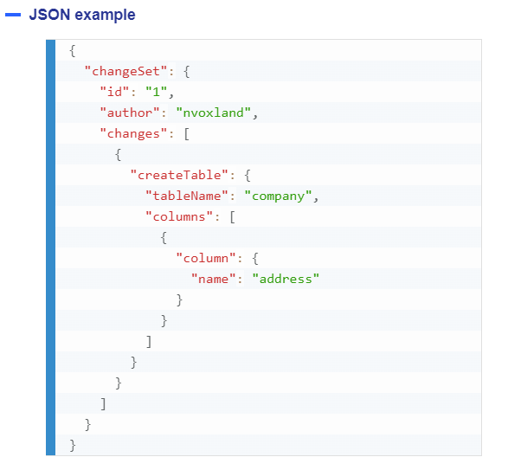
Supported formats
Notes:
There are different supported formats for your changes like.
SQL
XML JSON YAML
Although the most common I’ve seen from experience are SQL and XML.

Slide 8
Key words to understand
Change log
Change set
Change type
Rollback
Notes:
Before going forward there are a few keywords to understand.
(forward) Change log – change log is list of files that contain changes. You need only one change log per database
(forward)
Change set – change set is a file that you put your changes in, each change set has to be put in the change log or else it will not be executed.
(forward)
Change type – change type is the changes you make for your database, like adding a column, removing it, or even adding a whole new table.
(forward)
Rollback – Rollback is reversion of changes made in a changeset file.

Slide 9
Hierarchy of change files
Changelog: Contains multiple Changesets
Changeset: Contains multiple Changetypes
Changetype: contains changes to the database
Notes:
So how do those change logs and change sets connect to each other ? It’s pretty simple.
(forward)
(forward)
There is a single change log for a database, that contains one or more change sets.
(forward)
And each change set can contain multiple change types inside it. It important to understand while change log and change set are files.
Change type is not a file, it’s an action to make a change for the underlying database.
Note that each changeset is a single transaction so if you have multiple changes types in your change set and one fails all of the changes from the change set will be rollbacked.

Slide 10
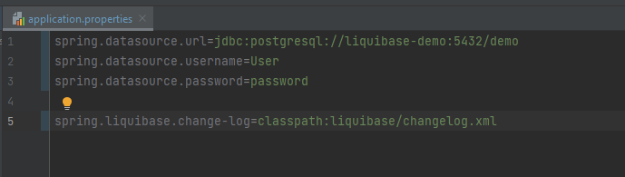
Deeper look
Notes:
Let’s take a deep look on how everything looks.
As you can see I’m using spring boot with postgres database and will be using it through out this presentation.
First we need to setup our application.properties file to contain the following data.
Define connection to the database with Datasource url, username and password.
Then define our change-log location which is the main file which we get our updates from.

Slide 11
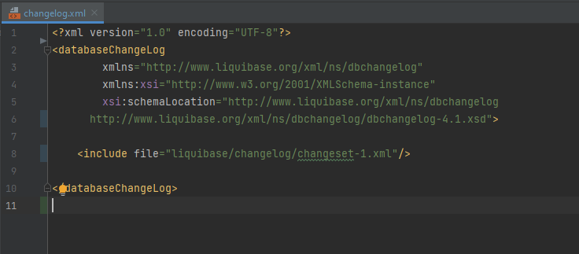
Deeper look
<includeAll path="liquibase/changelog/"/>
Notes:
This is how a changelog looks with one changeset added.
To successfully enable rollbacks and keep track of changes each change set should have an id associated with it
The id should be unique in this case it’s a number that would have been incremented each time a new change set is included.
There is also an option to include all changesets from a given directory
Using includeAll tag (forward)
As you can see I’m only passing the main directory that contains changesets, not the individual changeset.

Slide 12
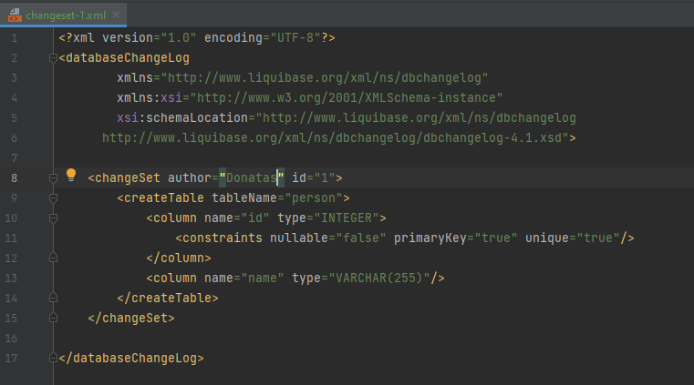
Deeper look
Notes:
And here is the contains of the change set.
As you can see I have defined author and id with the change set.
After xml format to create a table with the name of person
And column id.
Which is of type Integer.
And then adding constraints to the column that it’s a primary key.
That’s unique and can’t be null.
The second column I create is name that is of type varchar
After this changeset executes ill have a table in my database that I’ve defined in this change set.

Slide 13
QA
Demo time!

